Slide 1
Image Compression using PCA and K-Means Clustering
TEAM – PERFECT DEALERS
K.Vishnu Sainadh – BL.EN.U4AIE19028
K.Satwik - BL.EN.U4AIE19034
V.Ashrith - BL.EN.U4AIE19066

Slide 2
INTRODUCTION
Image compression algorithms take advantage of visual perception and the statistical properties of image data to provide superior results.
There are two kinds of image compression methods — lossless vs lossy.
We are comparing image compression techniques based on Principal Component Analysis (PCA) and K-means Clustering.
Thus, it will reduce the image size making it more efficient in the storage.

Slide 3
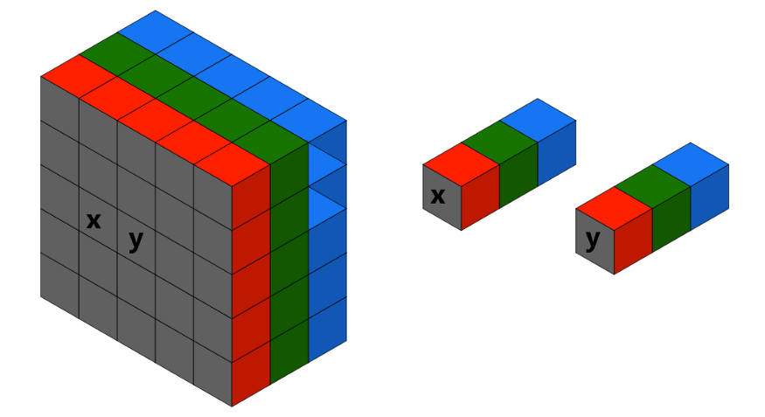
INTRODUCTION
PCA is based on the reduction of the image vectors of the image using the principal ones with multiple factors.
K-Means clustering algorithm reduces the number of colors so that it only needs to store certain numbers of RGB values.

Slide 4
K MEANS CLUSTERING
K-Means Clustering is an unsupervised machine learning algorithm.
K-Means algorithm is a centroid based clustering technique. This technique cluster the dataset into k different clusters. Each cluster in the k-means clustering algorithm is represented by its centroid point.
It is an iterative algorithm that tries to partition the dataset into K pre-defined distinct non-overlapping subgroups (clusters) where each data point belongs to only one group.

Slide 5
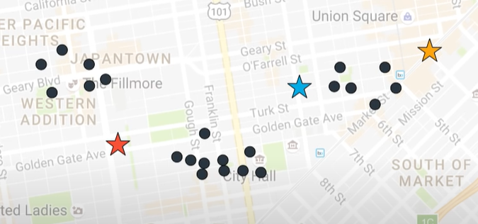
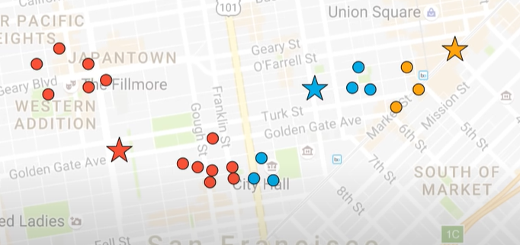
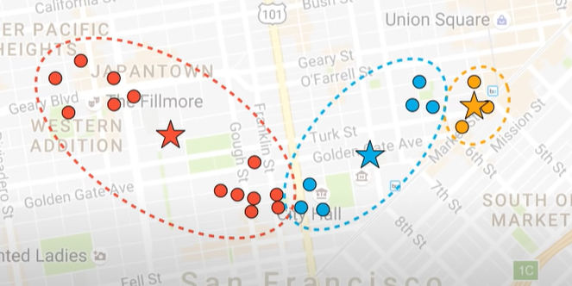
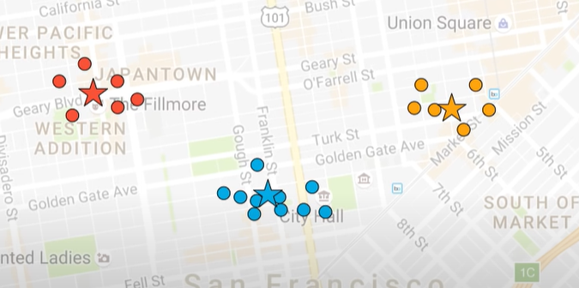
EXAMPLE

Slide 6
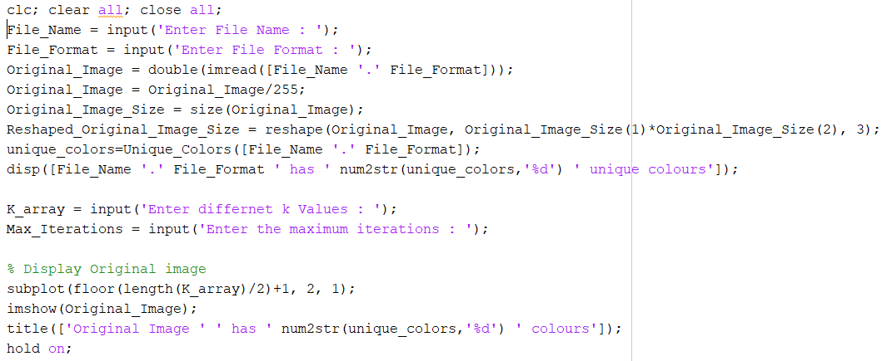
CODE SNAPSHOT

Slide 7
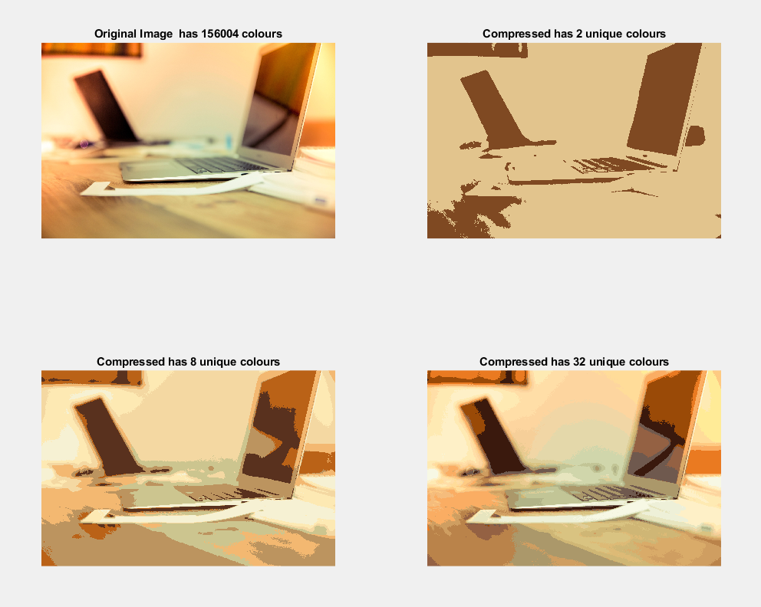
OUTPUT

Slide 8
Principal Component Analysis
Principal component analysis (PCA) is the process of computing the principal components and using them to change the basis of the data, sometimes only using the first few and ignoring the rest.
It is a way of identifying patterns in data, and expressing the data in such a way as to highlight their similarities and differences.
PCA is a dimensionality-reduction method for reducing the dimensionality of large data sets by transforming a large set of variables into a smaller one that nevertheless contains the majority of the information in the large set.

Slide 9
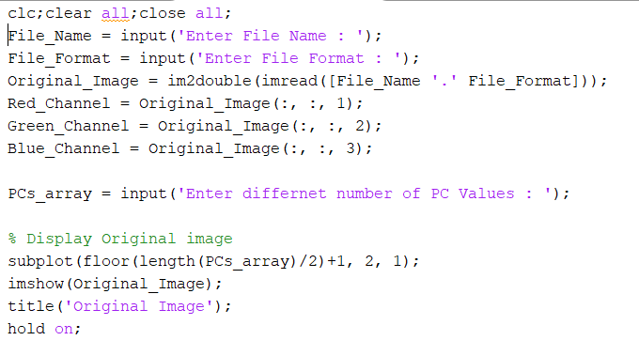
CODE SNAPSHOT

Slide 10
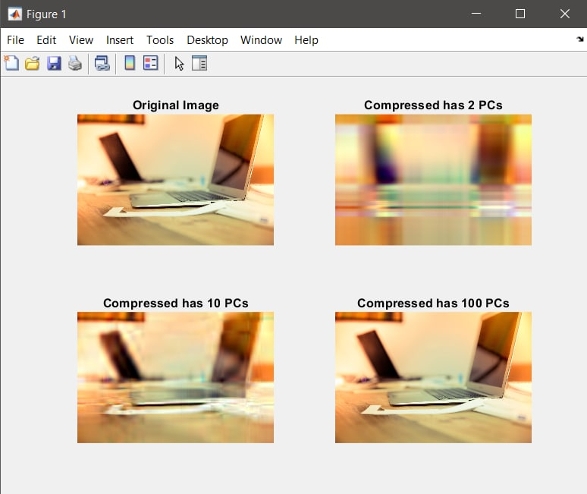
OUTPUT

Slide 11
LET'S SEE OUR IMPLEMENTATION

